Slide 1
MUGOYA DIHFAHSIH
2100702353
2021/HD05/2353U

Slide 2
Micro-services Bad smells
QTN1. Review various microservices bad smells(highlight them)
QTN2. Give a specific scenario of existence of microservice bad smells
QTN3. How to avoid these Microservice Bad smells
QTN4. Look out for the related anti patterns.
QTN5. How to detect these Microservice Bad Smells

Slide 3
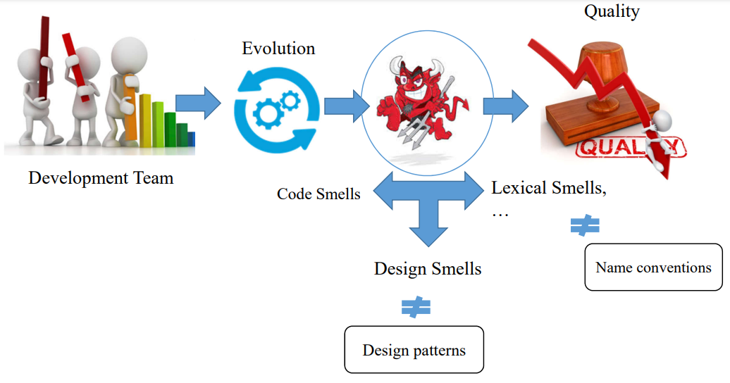

Slide 4
What are microservices
Microservice architecture is a variant of Service Oriented architecture structural style that arranges an application as a collection of loosely coupled services. The goal of microservices is that teams can bring their services to life independent of others.
Microservices enable independent deployment, allowing small teams to work on separated and focused services by using the most suitable technologies for their job that can be deployed and scaled independently.
It is a newly developed architectural style that is supported by platforms like nginx and kubernetes.

Slide 5
Microservice bad smells
On definition of microservice bad smells, code smells and architectural smells are symptoms of poor design that can hinder code understandability and thus decrease maintainability.
Microservice smells are indicators of situations such as undesired patterns, anti-patterns or bad practices that negatively affect software quality attributes such as understandability, extendibility, testability, reusability and maintainability of system under development .
During microservices migrations, practitioners face common problems due to their lack of knowledge regarding bad practices and patterns.
If not handled well, migration from monolith architecture to microservice can lead to a technical debt

Slide 6
Microservices Smells
When the development teams implement software features with poor design, bad code or neglect the proper software development guidelines, this negatively impacts the services
Smells in microservices can be categorized as follows;
Code smells (low level or local problems)
These are due to poor coding decisions and practices.
Examples include; Large classes, long methods, duplicated code, inappropriate naming
Anti-patterns(High level or global problem)
Poor solutions to recurring design problems as opposed to design patterns

Slide 7
Examples of microservice smells
Leak of Service Abstraction,
Enterprise Service Bus Usage,
Inappropriate Service Intimacy,
Microservice Greedy,
Not Having an API Gateway,
Too many Standards and
Moderate bad practices;
API Versioning,
Timeout,
Static Contract Pitfall,
Data Ownership
The most harmful bad practices are;
Hard coded IPs and Ports
Shared Persistency
Cyclic Dependency
Shared Libraries
Wrong Cuts

Slide 8
Existence of bad smells
According to (On the Definition of Microservice Bad Smells) research, Micoservices Practitioners attending several events and conferences in different years were interviewed.
The practitioners reported a total of 265 different bad practices together with the solutions they had applied to overcome them
These were coded into 11 smells by the researchers, indicating how they were identified, problems caused and solutions.
These smells due to there severity to the applications were considered anti-patterns as their occurrence to the microservices negatively impacted the software development practitioners.
These are discussed in details in Anti-patterns section

Slide 9
Detection of bad smells using Static code analysis
The most commonly used method of bad smells detection is use of static code analysis.
Using this technique application representation is created through several processes including classes, methods, fields, tokenization and parsing.
It can be categorized into bytecode analysis and in source code analysis
1. Bytecode analysis:
This uses the application’s compiled code and is useful in uncovering endpoints, components, authorization policy enforcements, classes, and methods
However, the disadvantage is that not all languages have a bytecode.
2. In source code analysis:
We parse through the source code of the application without having to compile it into an immediate representation.

Slide 10
Detecting Microservices Bad smells
While there are many tools for detecting bad smells in monolithic architecture, these tools are not well developed in microservices.
According to (Towards Microservice Smells Detection) research, they suggest the use of a tool called arcan of three smells(Shared Persistence, Hard-Coded Endpoints, and Cyclic Dependency.).
According to the research, these three smells were identified by the experienced developers as the most harmful bad practices during the development of microservices-based systems.
The arcan tool was then used to detect the three kinds of smells in five open source projects

Slide 11
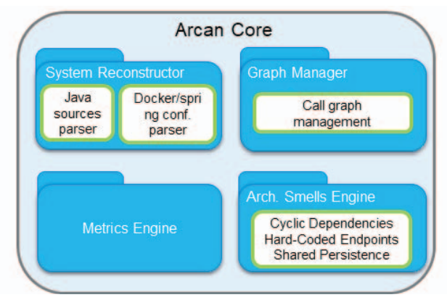

Slide 12
Archan Detetector
Arcan consists of four components, which manage the different steps of the provided analysis
1. System Reconstruction; This contains parsers that make the tool suitable to detect microservice smells by scanning the docker files
2. Architectural Smells Engine: This contains three smell detectors to detect each of the smells.
3. Graph Manager: Arcan computations rely on a graph database technology to represent the project under analysis. Graph calls represent each microservice in this analysis

Slide 13
Using arcan tool developers are able to spot the three microservice smells, thereby reducing the risk of Technical Date due to Hard-Coded Endpoints and reducing coupling among services by removing Shared Persistence and Cyclic Dependencies smells.
This detection tool is limited to Java as a programming language and to a specific framework called Spring

Slide 14
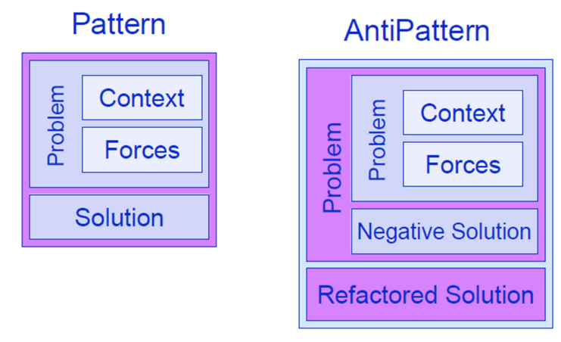
Microservices Smells: Anti-patterns

Slide 15
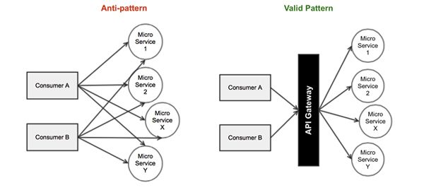
Anti-patterns in Microservices

Slide 16
Anti-patterns
Design patterns relate to repeating solutions to the issues often found in software programs but Anti-patterns are recurring programming practices that cause problems other than solving them
They are bad practices that lead to negative consequences in microservices
These impact program comprehension, software evolution and maintenance activities.
It is important to detect them early in software development process to reduce the maintenance costs

Slide 17
Anti-patterns
Anti-patterns can be a major hindrance to implementing microservices in an enterprise successfully
Over engineering, incorrect application of design patterns, failure to adhere to recommended practices contribute to occurrence of these problems.
Classifying the anti-patterns into a taxonomy helps in coming up with aggregated ways of avoiding these bad practices in microservices

Slide 18
Microservices Anti-Patterns Taxonomy
Technical Anti-patterns
Internal: Anti-patterns that impact individual microservices
API Versioning
Hard Coded end-points
Inappropriate Service intimacy
Local logging
Megaservice
Communication: Anti-patterns related to communication between microservices
Cyclic Dependencies
ESB usage
No API-Gateway
Shared Libraries
Others
Wrong Cuts
Shared Persistence
Lack of Monitoring

Slide 19
Organizational Anti-patterns
Team-oriented: Anti-patterns related to team dynamics
Legacy Organization
Non-homogeneous adoption
Common ownership
Microservice greed
Pride
Technology and tool oriented
Focus on latest technologies
Lack of microservice skeleton
No DevOps Tools

Slide 20
Common Microservice anti-patterns
1. Dependency Disorder
This an anti-pattern that occurs when you know that the services must be deployed in a particular way to ensure they are work as desired. This is caused when there is no control over function separation
To avoid this anti-pattern is by introducing an API Gateway. This helps to define service boundaries and analyze all the dependencies as well as evaluating deployment processes to reduce such service interdependencies.

Slide 21
2. Wrong Cuts
Wrong cuts in microservices are brought about if the overall system is separated into strongly coupled, dependent microservices.
Instead of creating a service, which acts autonomously on its specific business capability, we distribute one business capability among multiple services. The result is a large number of microservices that are dependent on each other and all we get in the end is a distributed monolith system.
Splitting a monolithic application is always a complex task, especially because developers are used to splitting applications into horizontal layers (database, business logic, etc.) instead of business processes

Slide 22
How to avoid wrong cuts
1. Monolith First,
Building a simple monolithic system in the beginning can help us to identify parts of the system that can act autonomously, which in contrast is difficult to get right from the start.
2. Domain Driven Design,
This helps to identify the correct boundaries of our system
3. Think Messages First,
Basing our system design on the messages sent within the system and not the objects in the domain. By focusing on communication between microservices we can minimize coupling between services.

Slide 23
3. Shared Persistency
Even if the code is correctly cut in our system, we can still create coupling by other means. One such problem is shared persistency.
This is brought about when one or more services access the same persistent data, resulting into a problem of inability to change the structure of the data because several services are dependent on the data format and the synchronization problems.
This anti-pattern is a result of microservices sharing a datastore, for a monolithic architecture this practice is very recommended but considered a bad practice for distributed microservices.
This eventually causes resource contention as many different services are accessing the same resource.
A shared datastore in a distributed microservices architecture can create deployment problems as a change in the database schema the services communicating with the database will be affected.

Slide 24
Example of shared persistence
Insurance Database is shared by all the microservices and there is a policy providing access to the database.
This creates development time coupling because a change in sales microservice needs to coordinate schema changes with the customer microservice.
This pattern creates dependencies among the development teams and introduces runtime coupling because all the microservices share the same database

Slide 25
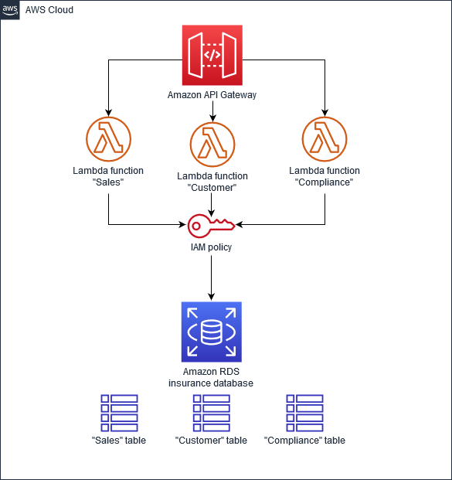

Slide 26
Avoiding shared persistence in microservices
Implement the database-per-service pattern in which each microservice is served by an independent database and in case of interdependence, create a an independent service to handle this.
Completely redesigning the existing data layer to break the coupling brought about by the shared database among the microservices.
Multiple services should not access databases in a microservice architecture due to high collaboration required across teams instead, tables should be accessible by a single service and services should communicate via an API.

Slide 27
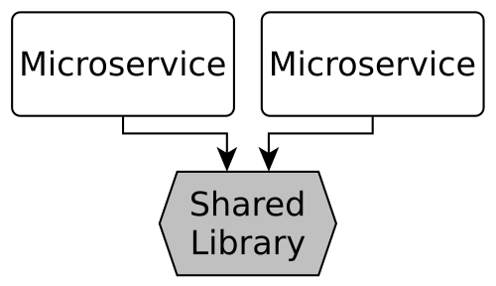
4. Shared Libraries bad smell
A reusable library speeds up the development, but it leads to coupling between the microservices. Consequently in long-term it slows down the development, increases the coordination effort and hinders modernization.
The microservices are not independent any longer. Especially don’t use shared libraries for business logic and models. Instead, accept redundancy, introduce a shared service or reslice your microservices

Slide 28
Shared Libraries
But even if our services are decoupled in terms of functionality and persistency, we can create coupling via shared libraries.
This is brought about by developer principle of Don’t Repeat Yourself or Dry.
If there is need to update the shared library, there is a problem because this is shared across multiple services and any change in it will affect other services.
Shared libraries cause technical coupling because they are specific to a given language especially frameworks.
Depending on shared libraries inhibit developers from changing service language to another.

Slide 29
How to avoid shared libraries bad smells
Testing whether the library is too specific from open source perspective, if it is open source then it can be used among services.
Generate library code instead of writing it, instead of writing shared libraries for the system, the focus should be put on generating API specification from which we can generate our API clients for every language and service.
Shared libraries should be implemented in a way that provide cross-cutting infrastructure rather than service domain logic or product functionality.
Apply strangler pattern where third party API client around your custom library so that you have freedom to make future changes without affecting other services

Slide 30
Best practices on Using Shared Libraries for microservices
Treat libraries that are shared like you would dependencies to 3rd party entities.
Make sure each component / library / service has a distinct business purpose.
Version them correctly and leave the decision which version of the library to use to the corresponding micro service teams.
Set up responsibilities for development and testing of shared libraries separately from the micro services teams.

Slide 31
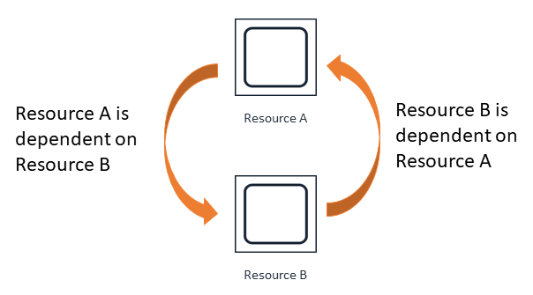
5. Cyclic Dependency bad smell
This is a relationship between two or more application modules that are code dependent.
This hurts the ability of a microservice to scale or to independently deploy as well as violating the circular dependencies principle.

Slide 32
Having circular dependencies between microservices will result in services that are hardly maintainable.
It is always hard to think on a single service at a time as they'll be highly coupled.
Lack of domain knowledge is the main cause of Cyclic dependency a microservice
Avoiding the cyclic dependency bad smell in microservices
Create a new package, and move the common dependencies there.
Implementing microservices following the Dependency Inversion Principle in which High level microservices are loosely coupled with the low level services

Slide 33
6. API Gateway
This practice becomes an anti-pattern when authentication, routing, throttling, are built for each service.
This would add complexity and there would be no consistency in the implementation.
This implementation makes maintaining of each service a daunting job.
To avoid this inconsistency in microservices, API gateway can be used to manage and monitor an application’s non functional needs as well as coordinate cross functional microservices to minimize roundtrips.

Slide 34
7. Entangled Data
This anti-pattern is found in scenarios where all the services have full access to all database objects.
This is a problem as it makes it hard to scale a module in a given application.
This leads to performance issues when making structural changes to the database because the data is entangled.
To avoid this, the best practice is to isolate data inside the application in a domain distinctive way. This ensures that only services relevant to a given domain have access to the data.
Always use access policies to control access to the database objects to a specific service.

Slide 35
8. Improper Versioning of Microservices.
This anti-pattern is due to many different independent services that are poorly versioned.
This leads to development of code that is extremely difficult to manage over time.
Improper versioning of services binds the consumers to a particular version of service thus increasing complexity and making service upgrades difficult.
To avoid this, it is a best practice to always design and architect a service for change, this allows efficient management and proper service upgrades.
Forexample specifying API version as part of the route URL.

Slide 36
References
SOEN6461: Software Design Methodologies, Zeinab (Azadeh) Kermansaravi Smells: Anti-patterns and Code smells
2. Microservices Anti-Patterns: A Taxonomy Davide Taibi1, Valentina Lenarduzzi1, Claus Pahl2
3. Automated Code-Smell Detection in Microservices Through Static Analysis: A Case Study
4. Towards Microservice Smells Detection; Ilaria Pigazzini Francesca Arcelli Valentina Lenarduzzi Davide Taibi
5. Modeling Microservices with DDD Paulo Merson pmerson@acm.org Joe Yoder –joe@refactory.com
6. On the Definition of Microservice Bad Smells Davide Taibi and Valentina Lenarduzzi, Tampere University of Technology

